Slide 1
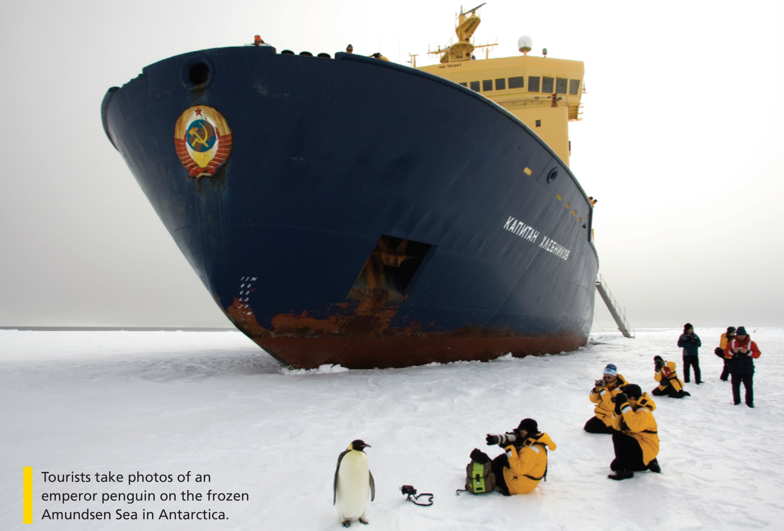

Bringing the world to the classroom and the classroom to life
NGL.CENGAGE.COM/ELT
A PART OF CENGAGE

Slide 2

FEATURES
94 Holidays and memories
Writers return to their roots
96 Walking for wildlife
Mike Fay: a personal approach to saving wild places
98 All aboard!
A report on global tourism
102 Questions and answers
A video about National Geographic Explorers’ lives
Unit 8-p. 93

Slide 3
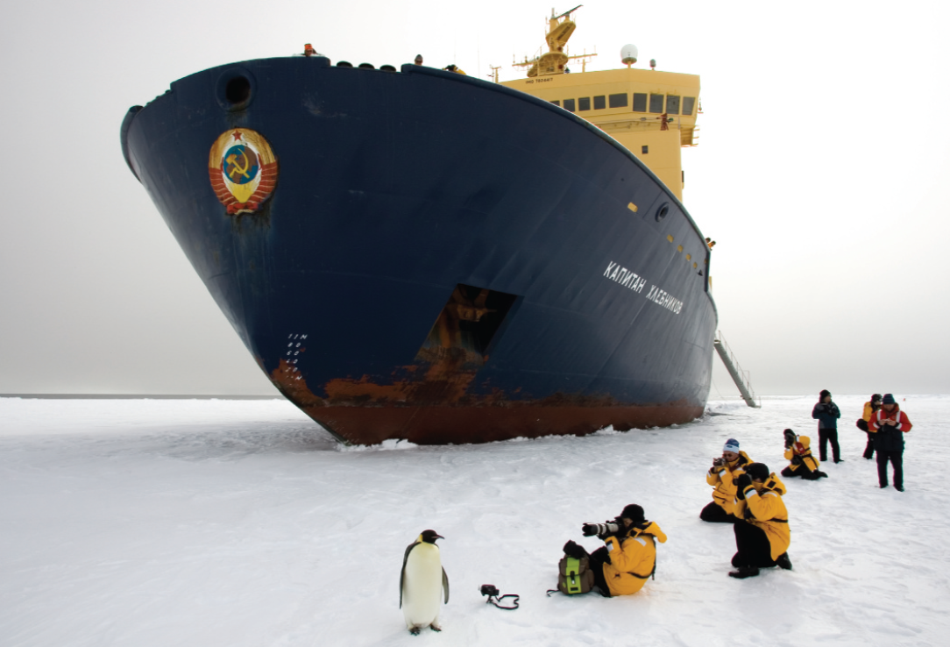
1 Work in pairs. Look at the photo. Discuss the questions.
1 What kind of holiday do you think this is? Why?
2 Do you think the people do this kind of trip often? Why? / Why not?
3 Would you like to take a trip like this?
Tourists take photos of an emperor penguin on the frozen Amundsen Sea in Antarctica.
EXAMPLE ANSWERS
1 It looks like a research trip or a holiday in Antarctica where tourists see and photograph wildlife. The people are wearing warm weather gear and have state-of-the-art cameras so it suggests a very specialist tourist trip.
2 No, it’s probably a once in a lifetime trip. It’s a long way to travel and must be very expensive. Conditions might be difficult or dangerous.
3 Students’ own answers
Unit 8-p. 93

Slide 4

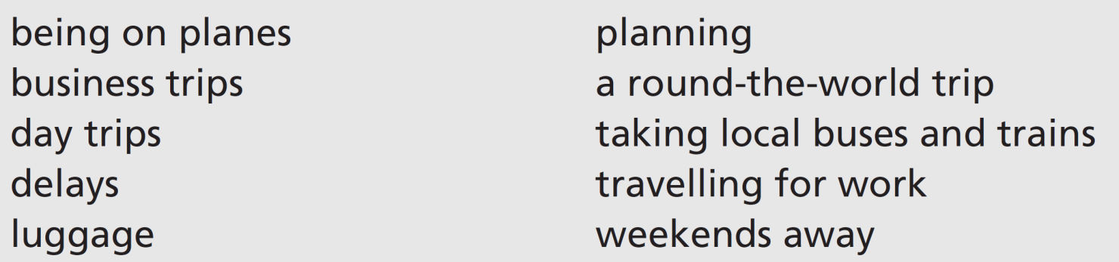
2 Listen to three people talking about travel. Write the number of the speaker (1–3) next to the things they talk about.
Track 61
3
1; 2
3
1
2
1
3
3
1
2
3 Listen again. Each speaker shares a travel tip. What are their tips? Discuss the tips with your partner.
Track 61
Speaker 1: Just take a small backpack with the essentials.
Speaker 2: The key to a good trip is good planning. Don’t leave anything to chance!
Speaker 3: Once the flight starts, take your watch off and relax. You have no control over the time you arrive, so why get stressed?
Unit 8-p. 93

Slide 5
Script
Track 61
1
A couple of years ago I went on a round-the-world trip with a friend. What an experience! The best bits were when we took local buses and trains – you know the kind of thing. They stop everywhere and it takes ages to get to where you’re going. On the other hand, we met some really interesting people on the buses in Peru. We learned a lot about the history of Peru. But I took far too much luggage with me – I couldn’t carry it easily and I worried about losing it. Just take a small backpack with the essentials, that’s my advice.
2
I haven’t travelled very much in the last few years. I’ve been on a few day trips to Liverpool and I’ve had a couple of weekends away to Scotland this year. I don’t go far any more. I’m more interested in the place I’m going to than in the journey. Edinburgh and Glasgow are fascinating cities. But in my experience, the key to a good trip is good planning. Don’t leave anything to chance!
3
I work in IT and I travel a lot – too much – for my job. I spend a lot of time on planes and in my car on the motorway, travelling to the projects I’m working on. I don’t particularly enjoy it, especially when there are delays, but it’s part of my job. I often get a very early flight from Gatwick and delays can mean I lose a whole working day. I have to go on business trips abroad several times a year. My travel tip? Once the flight starts, take your watch off and relax. You have no control over the time you arrive, so why get stressed?

Slide 6
4 Which countries or cities have you been to? Find people in your class who have had similar experiences to you.
A: Have you been to Vietnam?
B: Yes, we had a holiday there last year.
A: Me too! Where did you go?
Unit 8-p. 93

Slide 7

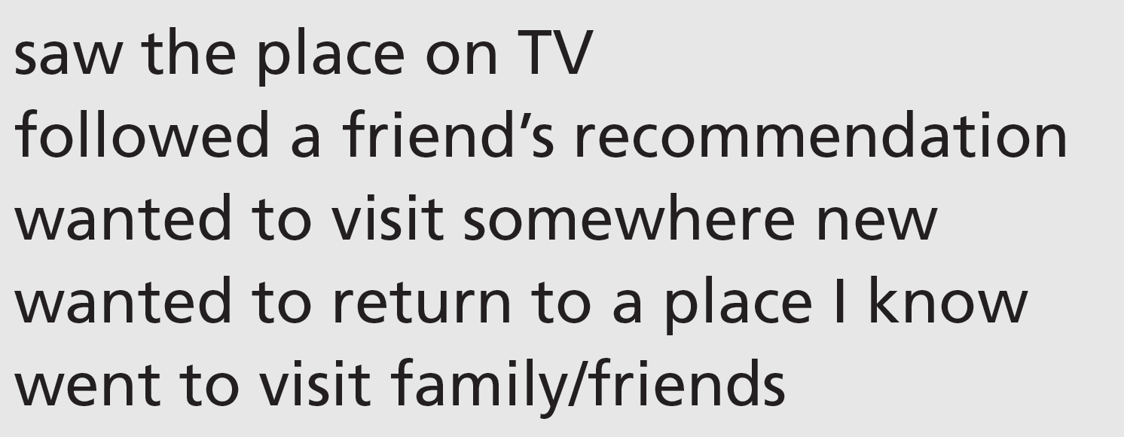
8a Holidays and memories
Vocabulary holiday activities
1 Work in pairs. Why did you choose the destination of your most recent holiday? Tell your partner.
Students’ own answers
8a-p. 94

Slide 8
2 Work in pairs. Match the activities (1–6) with the examples (a–f). What do you enjoy doing when you go on holiday? Give your own examples.
b
f
d
a
e
c
1 taking it easy
2 going sightseeing
3 having new experiences
4 being active
5 learning new things
6 spending time with friends or family
a hiking in the mountains
b lying on the beach
c playing board games
d riding on a camel
e taking a painting course
f visiting famous monuments
8a-p. 94

Slide 9
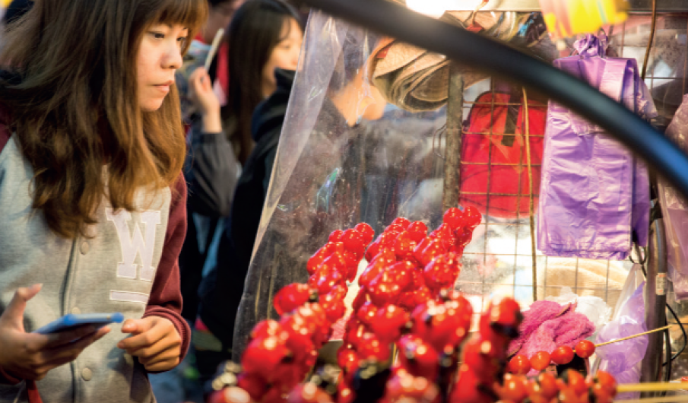
Reading
3 Look at the photo with the article. Which of these things (a– c) do you think it shows?
1 Lucy Chang is from Taiwan originally, but her home is London; her destination is Taipei
Liz Mullan is from Canada; her destination is Belfast Frank Rossellini is from New York; his destination is Sicily
a a coastline
b a market
c a village
4 Read the article and answer the questions.
1 Where are the writers from and what are their destinations?
2 Which writers haven’t been to these places before?
3 Which writer has problems with the language?
4 Which writer travels with his/her parents?
5 Which writer has to change his/her plans? Why?
2 Lucy Chang and Frank Rossellini
3 Lucy Chang
4 Frank Rossellini
5 Liz Mullan (she planned to walk along the coast but it was raining hard)
8a-p. 94

Slide 10

Track 62
1 Lucy Chang
I step off the train in Taipei and follow the crowd into Shilin, one of the city’s most famous night markets. Brightly-lit red, white and yellow signs are swinging above the market stalls. I’m not very good at reading Chinese characters, in spite of being from Taipei originally. Stall holders call out to me. It’s my first visit here and I’m too embarrassed to speak. Back home in London, I learned to say a few words, but right now my mind is blank. It’s not a good start to my trip.
2 Liz Mullan
Arriving at Belfast International Airport is always emotional. It feels like home. We head north to some of Europe’s highest ocean cliffs. After a couple of hours, we’re standing on the Giant’s Causeway. The wind almost blows us off the rocks into the North Atlantic Ocean. I look west towards home and imagine sailing across this wild ocean to Canada, like my great-grandfather did in 1890. We planned to walk along the coast like last time, but it’s raining hard so we decide to find a café and hot food. Maybe tomorrow will bring
the sun.
8a-p. 94

Slide 11
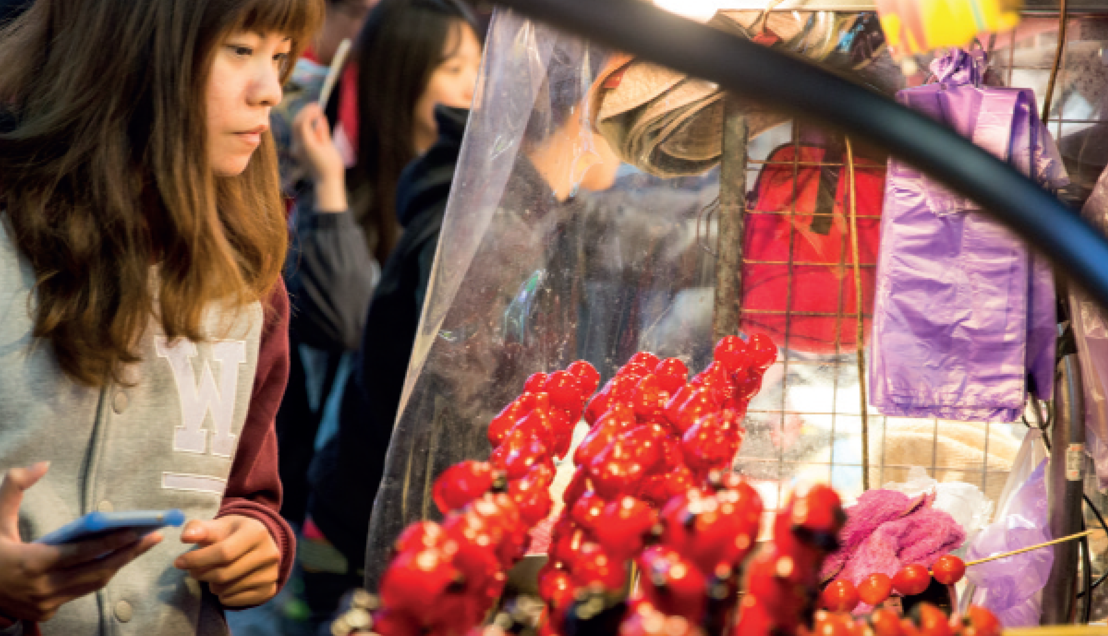
Track 62
3 Frank Rossellini
When I was a child, my parents always promised to take me to Sicily one day. Finally, when they are both in their eighties, we have managed to get here. In this tiny village, we sit down to a dinner with lots of aunts, uncles and cousins. Eating together is still the most important part of the day here. After enormous plates of sausage, pasta, salads and homemade bread, everyone enjoys telling us stories of the friends and family members who left for New York decades earlier. It feels great to be here and I think about coming back again in the future.
8a-p. 94

Slide 12
5 Which activities in Exercise 2 did the three writers do?
Lucy Chang: 3 having new experiences (also, arguably, 2 going sightseeing, as she visits a famous night market)
Liz Mullan: 2 going sightseeing, as they go to the Giant’s Causeway; 1 taking it easy – they decide to find a cafe and hot food; (students may say 4 being active – but, although they plan a walk, they don’t actually do it)
Frank Rossellini: 6 spending time with family; (also, 1 taking it easy)
8a-p. 94

Slide 13
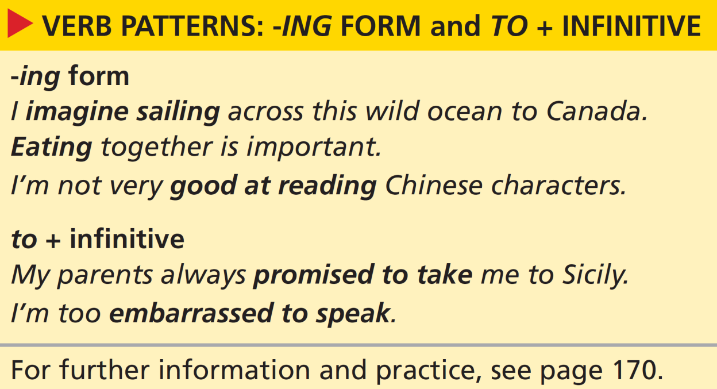

Grammar verb patterns: -ing form and to + infinitive
8a-p. 95

Slide 14
6 Look at the grammar box. Choose the correct option to complete these sentences. Then find an example of each use in the article.
1 We use the -ing form of the verb after certain verbs, as the subject of a sentence and after adjectives / prepositions.
2 We use to + infinitive form of the verb after certain verbs and after adjectives / prepositions.
Examples of -ing form in the article after certain verbs: imagine sailing, enjoys telling
as the subject of a sentence: Arriving, Eating together
after prepositions: good at reading, in spite of being, think about coming back
Examples of to + infinitive after certain verbs: learned to say, planned to walk, decide to find, promised to take, managed to get
after adjectives: embarrassed to speak, great to be
8a-p. 95

Slide 15
7 Each option in these sentences is grammatically possible but one option isn’t true, according to the article. Which one?
1 Lucy Chang described / finished / mentioned going to the market.
2 Lucy Chang needs / manages / wants to speak Chinese.
3 Liz Mullan adores / avoids / loves going to Ireland.
4 Liz Mullan expected / intended / threatened to walk along the coast.
5 Frank Rossellini’s parents planned / refused / wanted to travel to Sicily.
6 Frank Rossellini fails / hopes / intends to return to the village.
8a-p. 95

Slide 16
8 Choose the correct option to complete the sentences. Then work in pairs. Tell your partner which sentences you agree with.
1 Travelling / To travel by train is usually pleasant.
2 Good hotels are easy finding / to find.
3 Cycling / To cycle can be a good way of seeing a new city.
4 Sleeping / To sleep on a plane can be difficult.
5 Some hotels are too expensive staying / to stay in.
6 I’m interested in trying / to try new things on holiday.
7 Going / To go on holiday with friends is always fun.
8 I get fed up with spending / to spend every day on the beach.
1 (subject of the sentence)
2 (after an adjective)
3 (subject of the sentence)
4 (subject of the sentence)
5 (after an adjective)
6 (after a preposition)
7 (subject of the sentence)
8 (after a preposition; fed up with = bored with)
8a-p. 95

Slide 17
9 Complete the conversation with the -ing form and to + infinitive form of the verbs. Then listen and check.
Track 63
Rose: Hi there, I’m Rose.
Matt: Hi, I’m Matt.
Rose: Is this your first time in Corfu?
Matt: No, actually. We come every year. We love 1 ___________ (stay) here.
Rose: So do we. We keep 2 ___________ (come) back year after year. It’s hard
3 ___________ (find) somewhere with everything you need for a holiday – great beaches, fantastic weather and something for everyone to do.
Matt: I know. Actually, there’s a paragliding class later – I fancy 4 _________ (try) that.
Rose: My friends want 5 ___________ (do) that too! To be honest,
6 ___________ (lie) by the pool is my idea of a holiday.
Matt: Oh, I get a bit bored with 7 ___________ (do) that after the first day or two. I need 8 ___________ (move) around and do things.
Rose: Well, why not? It’s a different way of 9 ___________ (relax), I suppose.
Matt: Yes, that’s right. Well, if you decide 10 ___________ (go) paragliding with your friends, we’ll see you there!
staying
coming
to find
trying
to do
lying
doing
to move
relaxing
to go
8a-p. 95

Slide 18
Script
Track 63
R = Rose, M = Matt
R: Hi there, I’m Rose.
M: Hi, I’m Matt.
R: Is this your first time in Corfu?
M: No, actually. We come every year. We love staying here.
R: So do we. We keep coming back year after year. It’s hard to find somewhere with everything you need for a holiday – great beaches, fantastic weather and something for everyone to do.
M: I know. Actually, there’s a paragliding class later – I fancy trying that.
R: My friends want to do that too! To be honest, lying by the pool is my idea of a holiday.
M: Oh, I get a bit bored with doing that after the first day or two. I need to move around and do things.
R: Well, why not? It’s a different way of relaxing, I suppose.
M: Yes, that’s right. Well, if you decide to go paragliding with your friends, we’ll see you there!

Slide 19

Listening and speaking
10 Listen to people talking about holidays and complete the sentences. Do you think they would be good holiday companions for you? Which person would you prefer to go on holiday with?
Track 64
1 I enjoy … .
2 I quite fancy … .
3 I don’t mind … .
4 I’d like … .
5 I can’t afford … .
6 I’m quite keen on … .
7 I don’t like … .
8 I’m interested in … .
9 I can’t stand … .
10 I’m happy … .
1 I enjoy doing lots of sports.
2 I quite fancy trying extreme sports.
3 I don’t mind walking long distances.
4 I’d like to see somewhere spectacular.
5 I can’t afford to go away for more than a week.
6 I’m quite keen on visiting historical places.
7 I don’t like sleeping outdoors.
8 I’m interested in learning other languages.
9 I can’t stand being in the sun.
10 I’m happy to share a room.
8a-p. 95

Slide 20
11 Think about how you would complete the sentences in Exercise 10. Then talk to people in your class and find someone who would make a good holiday companion.
12 Work with your holiday companion and decide what kind of holiday to have. Tell the class:
• where and when you would go
• how you’d get there
• where you’d stay
• what you’d do there and why
8a-p. 95

Slide 21
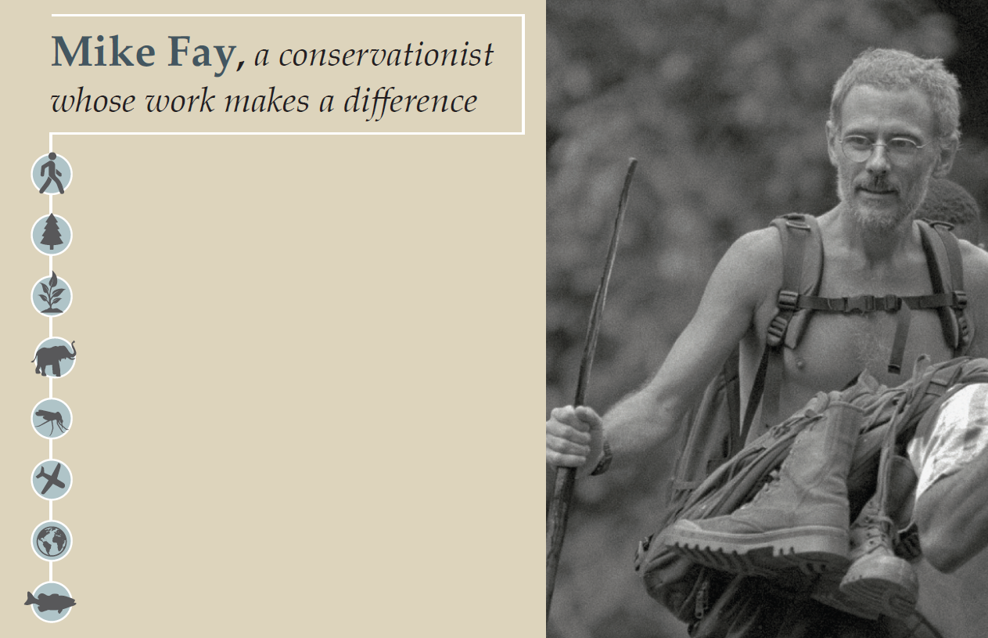
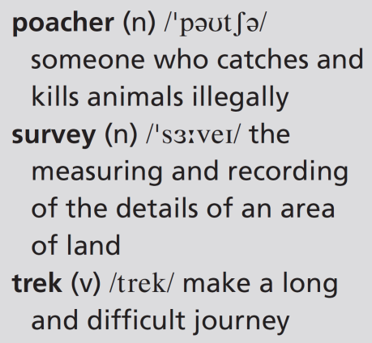
8b Walking for wildlife
trekked 10,000 kilometres in Africa and North America
counted giant redwood trees in North America, elephant populations in central Africa
created 13 national parks in Gabon
protected thousands of elephants from poachers
survived a malaria attack, an elephant attack, a plane crash
flown over the African continent for an aerial survey
uploaded thousands of photos to Google Earth
helped to create a marine park off the Gabon coast
8b-p. 96

Slide 22
Listening
1 What kind of work does a conservationist do? What is their main aim?
A conservationist is somebody whose job involves trying to protect natural environments. Conservationists might campaign to stop people or companies from cutting down trees, killing wildlife or polluting water supplies. They might work to stop plants or animals from going extinct.
2 Look at the information about Mike Fay. Do you think he’s a typical conservationist? Why? / Why not?
probably not, because he’s trekked 10,000 kilometres and has had some dangerous/exciting experiences.
8b-p. 96

Slide 23
3 Listen to an extract from a radio programme about Mike Fay. Complete the sentences.
Track 65
1 Mike Fay’s work is about saving the last ________________ on Earth.
2 He’s spent a total of more than ________________ years of his life on treks.
3 His usual luggage is a T-shirt, a pair of shorts and a ________________.
4 He’s walked in Africa, the United States and ________________.
5 He’s worried about how ________________ people will affect the planet.
wild places
two
pair of sandals
Canada
seven billion
8b-p. 96

Slide 24
4 Listen to the extract again and choose the correct option to complete the sentences.
Track 65
1 Recently, Fay has been flying / walking across Canada.
2 Mining companies have been looking for / producing gold and oil.
3 Mining companies have been digging up / destroying vast areas.
4 In Gabon, people have been asking / trying to set up mines near parks.
5 Work in pairs. Would you like to spend a year working with Mike Fay? Why? / Why not?
Students’ own ideas
8b-p. 96

Slide 25
Script
Track 65
When you’ve walked across half of Africa and you’ve walked up the west coast of North America, where do you go next? On tomorrow’s show my guest is a man who can give us the answer.
I’m talking about the conservationist Mike Fay – a man with a very personal way of saving what he calls the last wild places on Earth. For those of you who don’t know Mike Fay, he does some unusual things in his work with the Wildlife Conservation Society. For instance, he’s spent more than two years of his life trekking through some of the toughest places on the planet. And he often just takes a T-shirt, a pair of shorts and a pair of sandals on these treks. Fay says he has only slept in a bed about fifty times in ten years. The last time he was on the show, he’d just finished a survey of giant redwood trees on the west coast of the United States. What has he been doing since then? Well, he hasn’t been taking it easy! In fact, recently he’s been walking again, this time across Canada. In western Canada, mining companies have been looking for gold and oil. To do this, they’ve been digging up enormous areas – they’ve destroyed hundreds of square kilometres of wilderness. You can hear what Mike Fay feels about this in tomorrow’s show. And we’ll also find out what’s been happening to national parks in Gabon since Fay was there. We know that people have been trying to set up mines near the parks and the Gabonese government has stopped at least two mining operations. Hear more tomorrow in my interview with Mike Fay, and find out what he thinks a population of seven billion people might do to our planet.

Slide 26
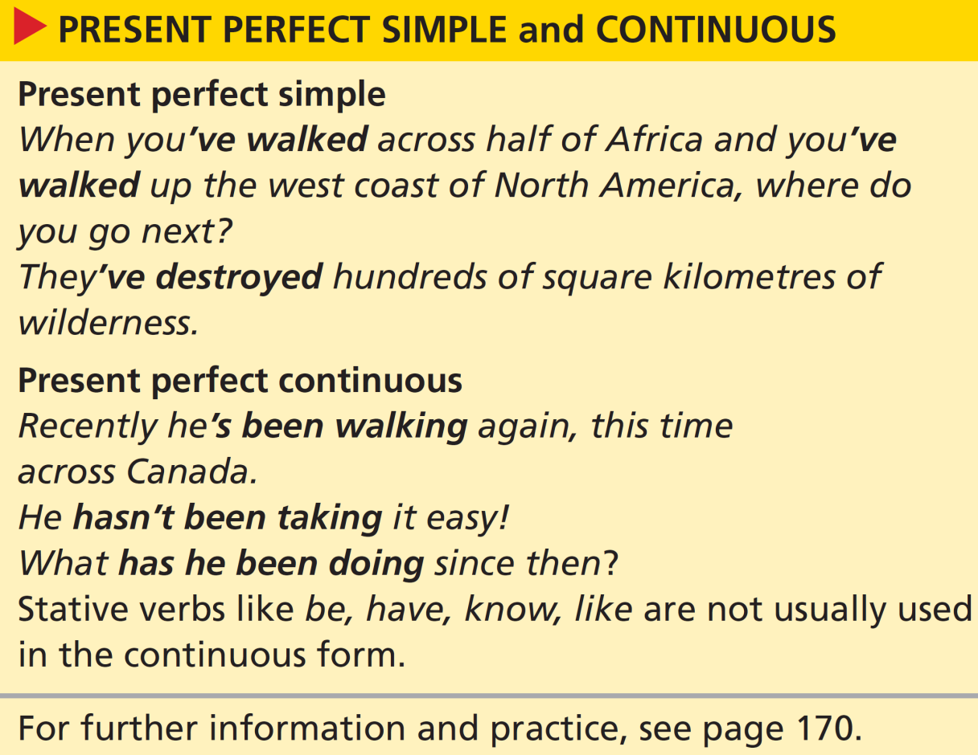
Grammar present perfect simple and continuous
6 Look at the grammar box. Answer the questions.
1 How do we form the present perfect simple? How do we form the present perfect continuous?
2 Which verb form emphasizes the duration or repetition of an activity? Which verb form emphasizes an action or an activity that is complete?
1 present perfect simple: has/have + past participle of main verb
present perfect continuous: has/have + been + -ing form of main verb
2 The present perfect expresses completion and result.
The present perfect continuous expresses repeated activity.
8b-p. 97

Slide 27
7 Complete the text with the present perfect simple and present perfect continuous form of the verbs.
This year, Mike Fay 1 _______________________________ (work) in Gabon. He 2 _______________________________ (check) the situation in the national parks and he 3 _______________________________ (discover) some problems. For example, poachers 4 ____________________________ (kill) elephants again. Fay 5 _______________________________ (talk) about ways of controlling poaching with the Gabonese government. As a result, the Gabonese president 6 _______________________________ (send) soldiers to several of the parks. So far, the poachers 7 ___________________________ (not / return). Meanwhile, for the past few years, foreign ships 8 ____________________________ (fish) in the marine park. The Gabonese government 9 ___________________________ (try) to find ways of dealing with this problem.
has been working
has been checking / has checked
has discovered
have been killing
has been talking / has talked
has sent
haven’t returned
have been fishing
have been trying
8b-p. 97

Slide 28
8 Write questions for Mike Fay with the present perfect simple and present perfect continuous form of the verbs.
1 What / you / do / recently?
2 you / prepare for / any new trips?
3 How / you / feel / since the plane crash?
4 How many photos / you / take / in your career?
5 How long / you / travel / alone?
6 you / be / anywhere dangerous lately?
1 What have you been doing recently?
2 Have you been preparing for any new trips?
3 How have you been feeling since the plane crash?
4 How many photos have you taken in your career?
5 How long have you been travelling alone?
6 Have you been anywhere dangerous lately?
8b-p. 97

Slide 29
9 Match the travel preparation activities (1–6) with the results (a–f). Then write two sentences.
I’ve been buying holiday clothes. I’ve spent a fortune.
b
f
a
e
c
d
1 buy holiday clothes
2 look for cheap flights
3 talk to travel agents
4 download tourist information
5 pack my suitcase
6 practise useful phrases in Thai
1 (see example)
2 (I’ve been looking for cheap flights. I haven’t found any.)
3 (I’ve been talking to travel agents. I’ve been on the phone all morning.)
4 (I’ve been downloading tourist information. I’ve printed a couple of pages.)
a be on the phone all morning
b spend a fortune
c run out of space
d not learn many
e print a couple of pages
f not find any
5 (I’ve been packing my suitcase. I’ve run out of space.)
6 (I’ve been practising useful phrases in Thai. I haven’t learnt/learned many.)
8b-p. 97

Slide 30
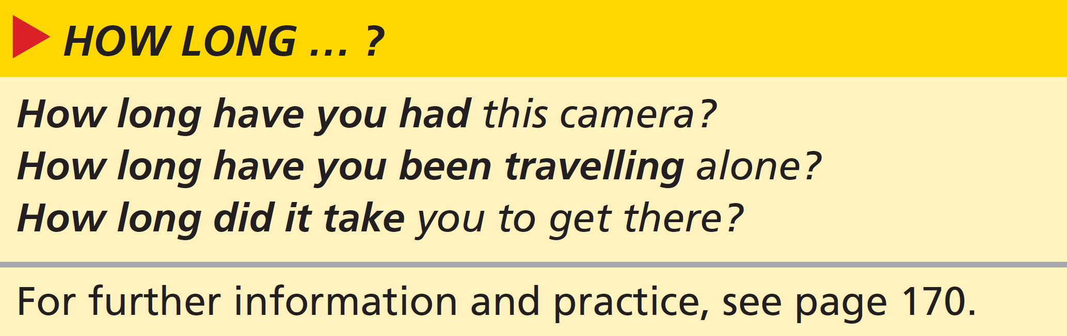
Grammar How long … ?
10 Look at the grammar box. Which verb form is used in each question? Why?
1 How long have you had this camera? = present perfect simple because it’s incomplete but uses a state verb
2 How long have you been travelling alone? = present perfect continuous because it’s an incomplete action which is repeated and has duration
3 How long did it take you? = past simple because it’s a finished past action
8b-p. 97

Slide 31
11 Match the questions (1–6) with the answers (a–e). Then work in pairs and continue the conversations.
1 How long have you been coming to this resort?
2 How long did the flight from London take?
3 How long have you known each other?
4 How long did you spend in Canada?
5 How long have you been waiting for the bus?
6 How long have you been here?
b
a
d
c
e
f
Example
A: How long have you known each other?
B: Not long – we met on holiday this spring.
A: Really? Where did you meet?
B: On holiday. We were both on the same tour bus.
a About ten hours non-stop.
b For the last four or five years.
c I was there for a couple of months.
d Not long – we met on holiday this spring.
e Only a few minutes. But I think we just missed one.
f We arrived yesterday morning.
A: How long have you been coming to this resort?
B: For the last four or five years.
A: Has it changed a lot in that time?
8b-p. 97

Slide 32
Speaking
12 What kinds of activities are you interested in? How long have you been doing them? Work in pairs and tell your partner. Ask follow-up questions. Use some of these ideas.
I’ve been … since/for …
I took it up when …
I’ve always/never …
In the last few … , I’ve …
EXAMPLE ANSWERS
I’ve been interested in stamp collecting / birdwatching since 2012 / for ten years.
I took it up when I left home / my wife left me.
I’ve always/never loved working with my hands.
In the last few years, I’ve found some rare Zambian stamps.
8b-p.97

Slide 33
8c All aboard!
Reading
EXAMPLE ANSWERS
1/2 Students’ own answers
1 Work in pairs. Discuss the questions.
1 Do many tourists come to your country or region? From which countries?
2 What do these tourists do? Activity holidays, backpacking, cultural sightseeing, ecotourism, or other holiday activities?
3 What are the advantages of this tourism? Are there any disadvantages?
3 Advantages: provides money and jobs for local people; makes sure places are protected; puts a place on the map – promotes a country in a positive way; improves local infrastructure; makes the place more lively with shops and restaurants and bars; an opportunity to meet people from different cultures
Disadvantages: overcrowding; pollution; too much development and construction; natural places can be spoilt; prices, particularly house prices, can affect local people; some tourists can be noisy or thoughtless
8c-p. 98

Slide 34
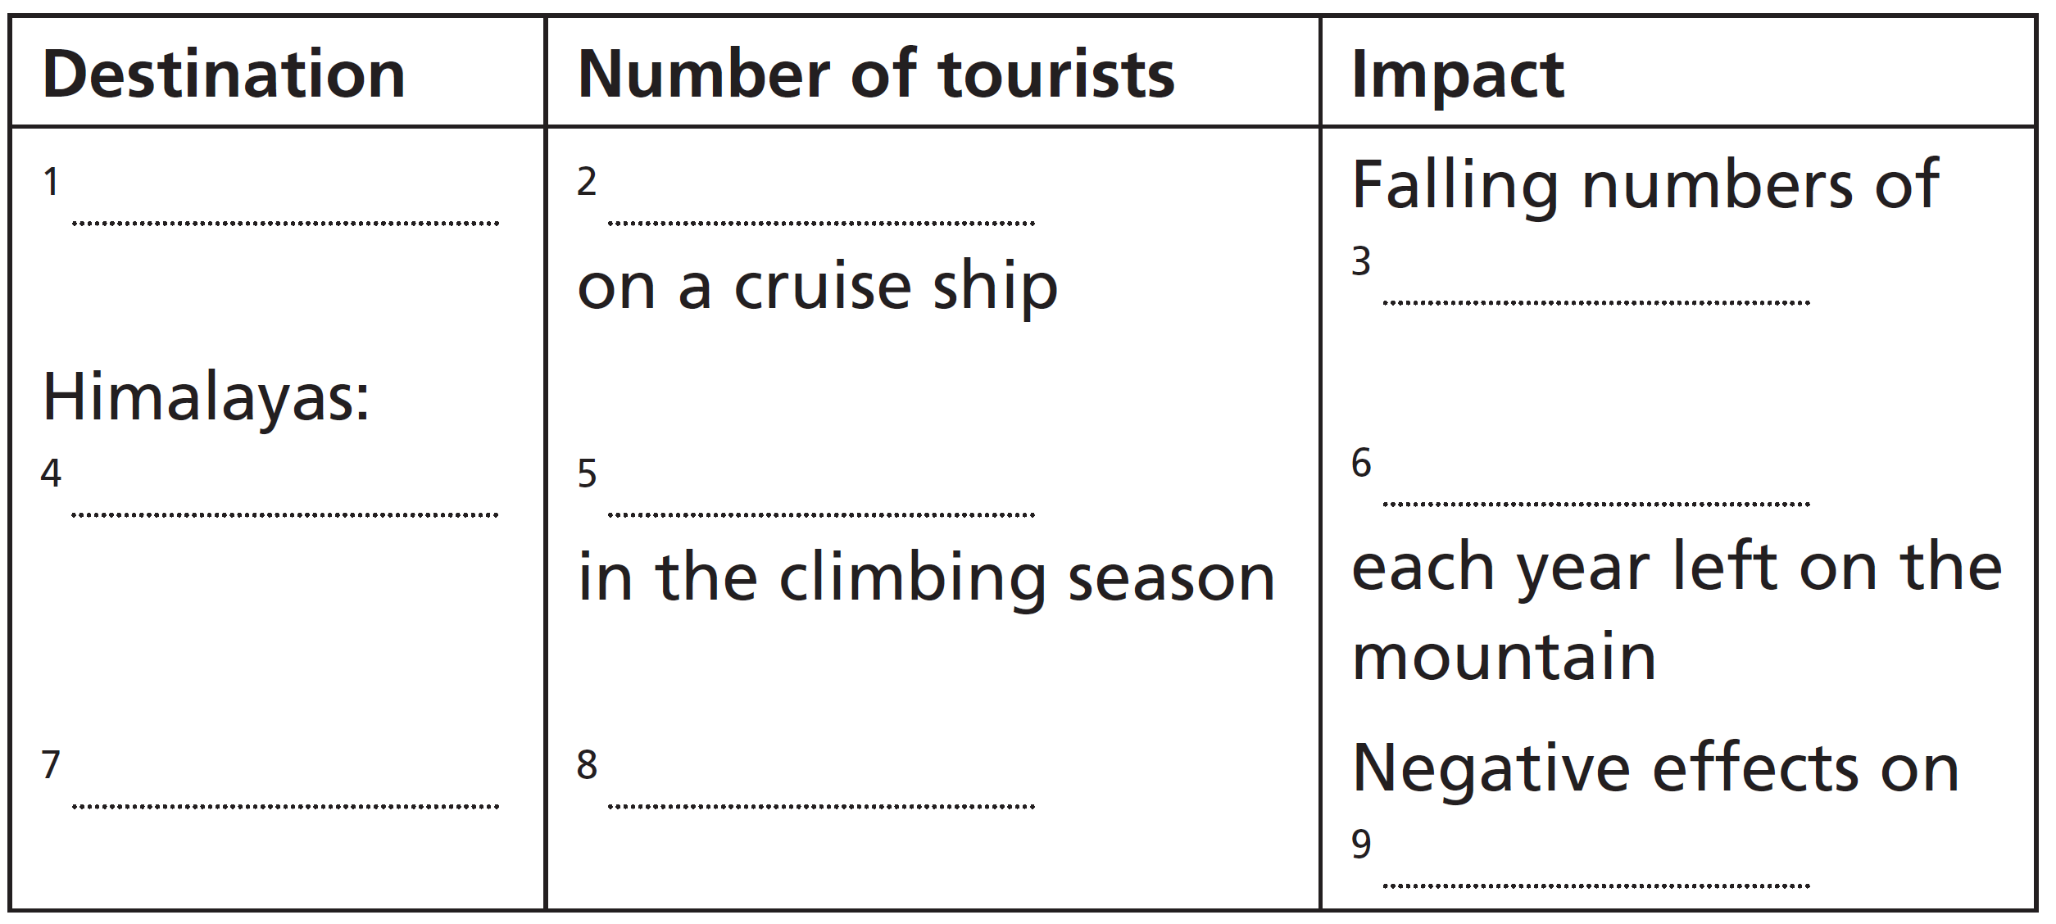
2 Read the article quickly. What is it about? Choose the best option (a–c).
a It describes extreme activities tourists can do.
b It compares the positive and negative effects of tourism.
c It talks about the impact of lots of tourists on a destination.
3 Read the article again and complete the table.
Patagonia
6,000
Magellanic penguins
Everest
about a thousand
rubbish
Balearic islands
thirteen million
(the) local environment
8c-p. 98

Slide 35
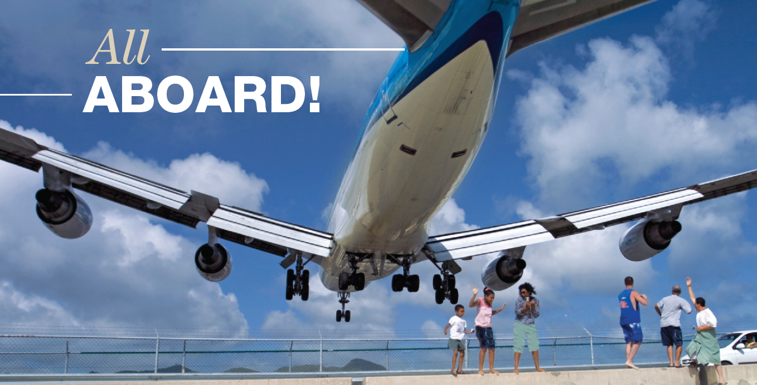
A plane comes in to land on the
Caribbean island of Saint Martin.
Track 66
The tourism industry started to grow rapidly in the middle of the last century and it’s been growing ever since. In the last twenty years especially, more and more people have been travelling to distant places around the world. It’s a wonderful thing, to be able to travel to destinations we had previously only read about or seen on television. But what kind of impact do large numbers of people have on these places?
8c-p. 99

Slide 36
Track 66
A voyage to the end of the Earth?
A large cruise ship can carry as many as six thousand passengers at a time, with about twenty-four million people going on cruises every year. Cruise ships drop about ninety thousand tons of waste into the oceans every year and each ship produces as much air pollution as five million cars. he effects of this are made even worse by the fact that cruises visit the same places over and over again, so the damage is repeated. In Patagonia, this has been having an effect on wildlife. The numbers of Magellanic penguins have been falling for some years now, for example.
Climbing to the top of the world
Far fewer people go climbing or trekking in the Himalayas than take a cruise, but in the short climbing season each May about a thousand people try to climb Everest. At times, there are actually queues of climbers on the route to the top. The difficult conditions mean that everyone needs to take a lot of equipment with them. Unfortunately, for the last few decades, climbers have been leaving their equipment on Everest. In recent years, clean-up teams have been organizing expeditions just to pick up this rubbish. The teams are made up of local and international climbers. One group has brought over eight tons of rubbish down from the mountain!
8c-p. 99

Slide 37

Track 66
Let’s all go to the beach
What happens when a region of about a million people is visited by thirteen million tourists every year? The Balearic Islands in the Mediterranean Sea have been dealing with this situation for decades. Where has the fresh water, the food, the petrol and the electricity for thirteen million tourists come from? And how have the islands maintained the quality of the beaches, the roads and the countryside? Recently, the government of the Balearic Islands decided to charge tourists an ecotax of two euros a day. This has been tried once before, but it wasn’t a success. However, the challenges have been getting harder every year. The money from the tax is used to reduce the negative effects of tourism on the local environment.
Difficult choices
So, should we travel or simply stay at home? Many destinations offer low-impact tourism such as ecotourism. It’s time to ask ourselves some difficult questions. Can we really visit the world’s beautiful places without destroying them?
8c-p. 99

Slide 38
4 Answer the questions with information from the article.
1 When did the tourism industry start to be successful?
2 Why are cruises bad for the environment? Find three reasons.
3 What have groups been doing to improve the environment on Everest?
4 What action has the government of the Balearic Islands taken, and why?
1 in the middle of the last century
2 Cruise ships drop about 90,000 tons of waste into the oceans every year; each ship produces as much air pollution as five million cars; cruises visit the same places over and over again, so the damage is repeated.
3 Clean-up teams have been organizing expeditions to pick up the rubbish left on Everest.
4 The government of the Balearic Islands has decided to charge tourists an eco-tax of two euros a day to maintain the quality of the beaches, the roads and the countryside.
8c-p. 98

Slide 39
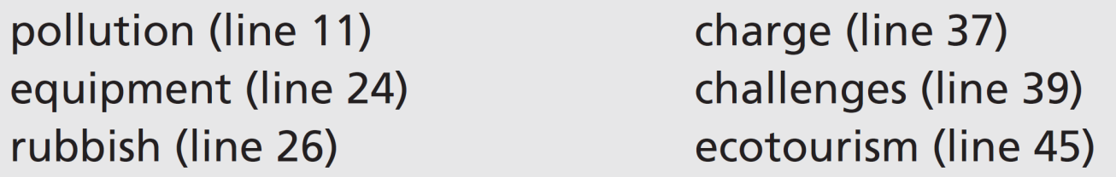
5 Find these words in the article. Look at how the words are used and try to guess their meaning. Then complete the sentences (1–6).
1 Airlines usually ______________ you a lot of money if your luggage is over the weight limit.
2 On average, each person in the UK produces about 500 kg of ______________ each year.
3 I don’t have much kitchen ______________ – just a microwave.
4 Speaking a new language can be one of the hardest ______________ when you travel abroad.
5 ______________ is a way of enjoying a holiday without damaging the environment.
6 Plastic is a major cause of ______________ in the oceans.
charge
rubbish
equipment
challenges
Ecotourism
pollution
8c-p. 98

Slide 40
Critical thinking close reading
6 According to the article, are these statements true (T) or false (F)? Or is there not enough information (N) in the article to say if the statements are true or false?
F
T
N
N
N
1 The tourism industry has grown steadily and has now reached its peak.
2 There are fewer Magellanic penguins since cruises started visiting Patagonia.
3 Climbers on Everest cause problems for the local population.
4 There’s not enough fresh water in the Balearic Islands in the holiday season.
5 It’s better to stay at home than be an ecotourist.
7 Work in pairs. Underline the sections of the article that helped you decide about the sentences in Exercise 6. Do you agree with each other?
See next slide for answers
8c-p. 98

Slide 41
Exercise 7
1 F: The tourism industry started to grow rapidly in the middle of the last century and it’s been growing ever since. (i.e. it hasn’t yet reached its peak)
2 T: In Patagonia, this (repeat visits by cruise ships) has been having an effect on wildlife. The numbers of Magellanic penguins have been falling for some years now, for example.
3 N: (There is no mention of how or whether the local population is affected in the text.)
4 N: (The text asks where the fresh water has to come from, but doesn’t say whether there is enough or not.)
5 N: (The text suggests that being an ecotourist is a good thing but doesn’t say whether it’s better or worse than staying at home.)

Slide 42
8 Work as a class. Discuss the questions.
1 Do you think an eco-tax on tourists is a good idea?
2 What is your answer to the final question in the article?
EXAMPLE ANSWERS
1 Students’ own ideas. An eco-tax might be good because it will raise money to protect the environment, make tourists more aware that they are having an impact on the environment, and potentially reduce the number of tourists.
2 Students’ own ideas
8c-p. 98

Slide 43
Speaking
9 Work in pairs. Look at these activities. Decide if they have a good or bad impact on the environment. Which ones does your family do?
EXAMPLE ANSWERS
1 flying to distant holiday destinations
2 recycling household waste (paper, glass, organic waste)
3 travelling by car
4 switching off lights and electrical appliances
5 saving water (turning off taps, not watering the garden)
6 using eco-friendly cleaning products
Flying to distant holiday destinations leaves a big carbon footprint – a lot of fuel is used and a lot of carbon dioxide and other pollutants are released.
Recycling household waste (paper, glass, organic waste, etc.) is good because it saves trees and other raw materials and avoids the dumping of materials.
Travelling by car uses petrol – a fossil fuel – which causes pollution and is therefore bad for the environment.
Switching off lights and electrical appliances saves electricity – it’s good for saving natural resources.
Saving water (turning off taps, not watering the garden) is good for the environment.
Using eco-friendly cleaning products is good because they avoid chemicals and other pollutants that can harm wildlife.
8c-p. 98

Slide 44
10 Work in groups. How easy is it for you and your family to live a green lifestyle?
A: We’ve been recycling paper for years. It’s not hard to remember to do if you have a special box for it.
B: We do that too.
8c-p. 98

Slide 45
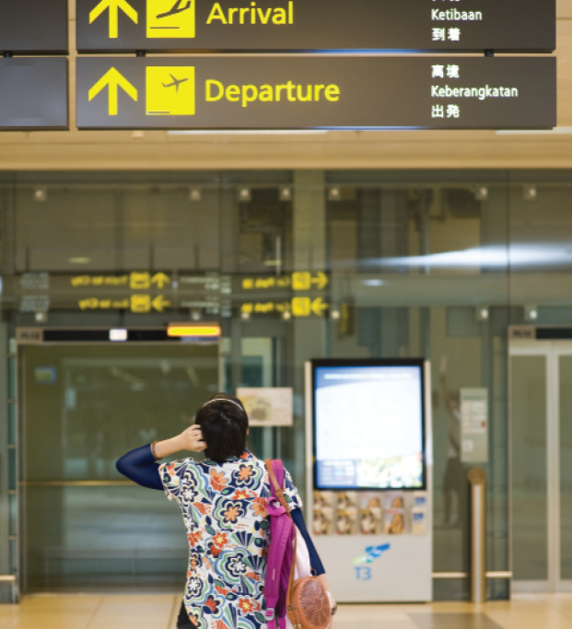
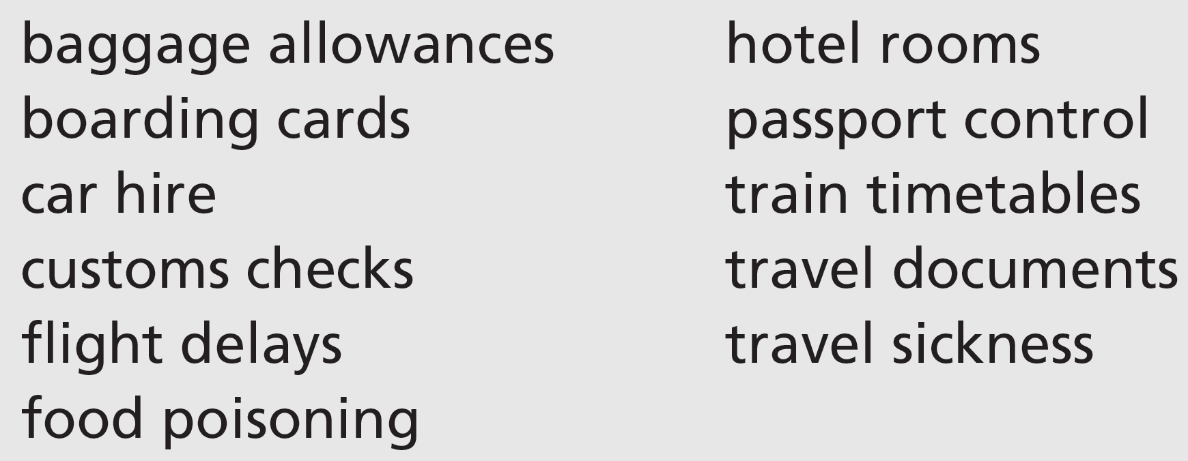
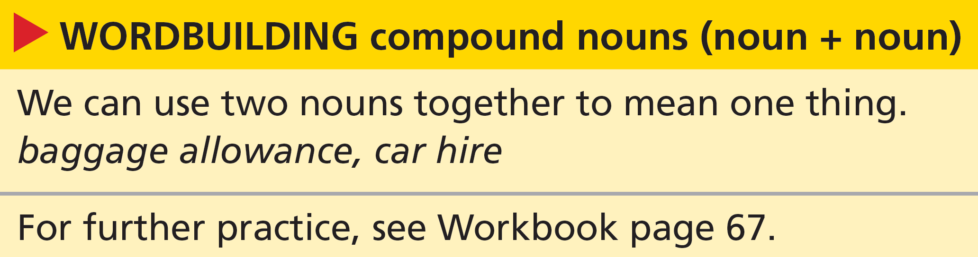
8d Is something wrong?
Vocabulary travel problems
1 Work in pairs. Have you ever had any travel problems involving these things? Tell your partner. Which of these problems can a tour guide help you with?
8d-p. 100

Slide 46
Real life dealing with problems
2 Listen to two conversations between a tour guide and tourists. Write the number of the conversation (1 or 2) next to the problem they talk about.
a The person has missed his/her flight home.
b Someone has had an accident.
c The luggage hasn’t arrived.
d The flight has been delayed.
e The person has lost his/her plane tickets.
f Someone is ill.
Track 67
8d-p. 100

Slide 47
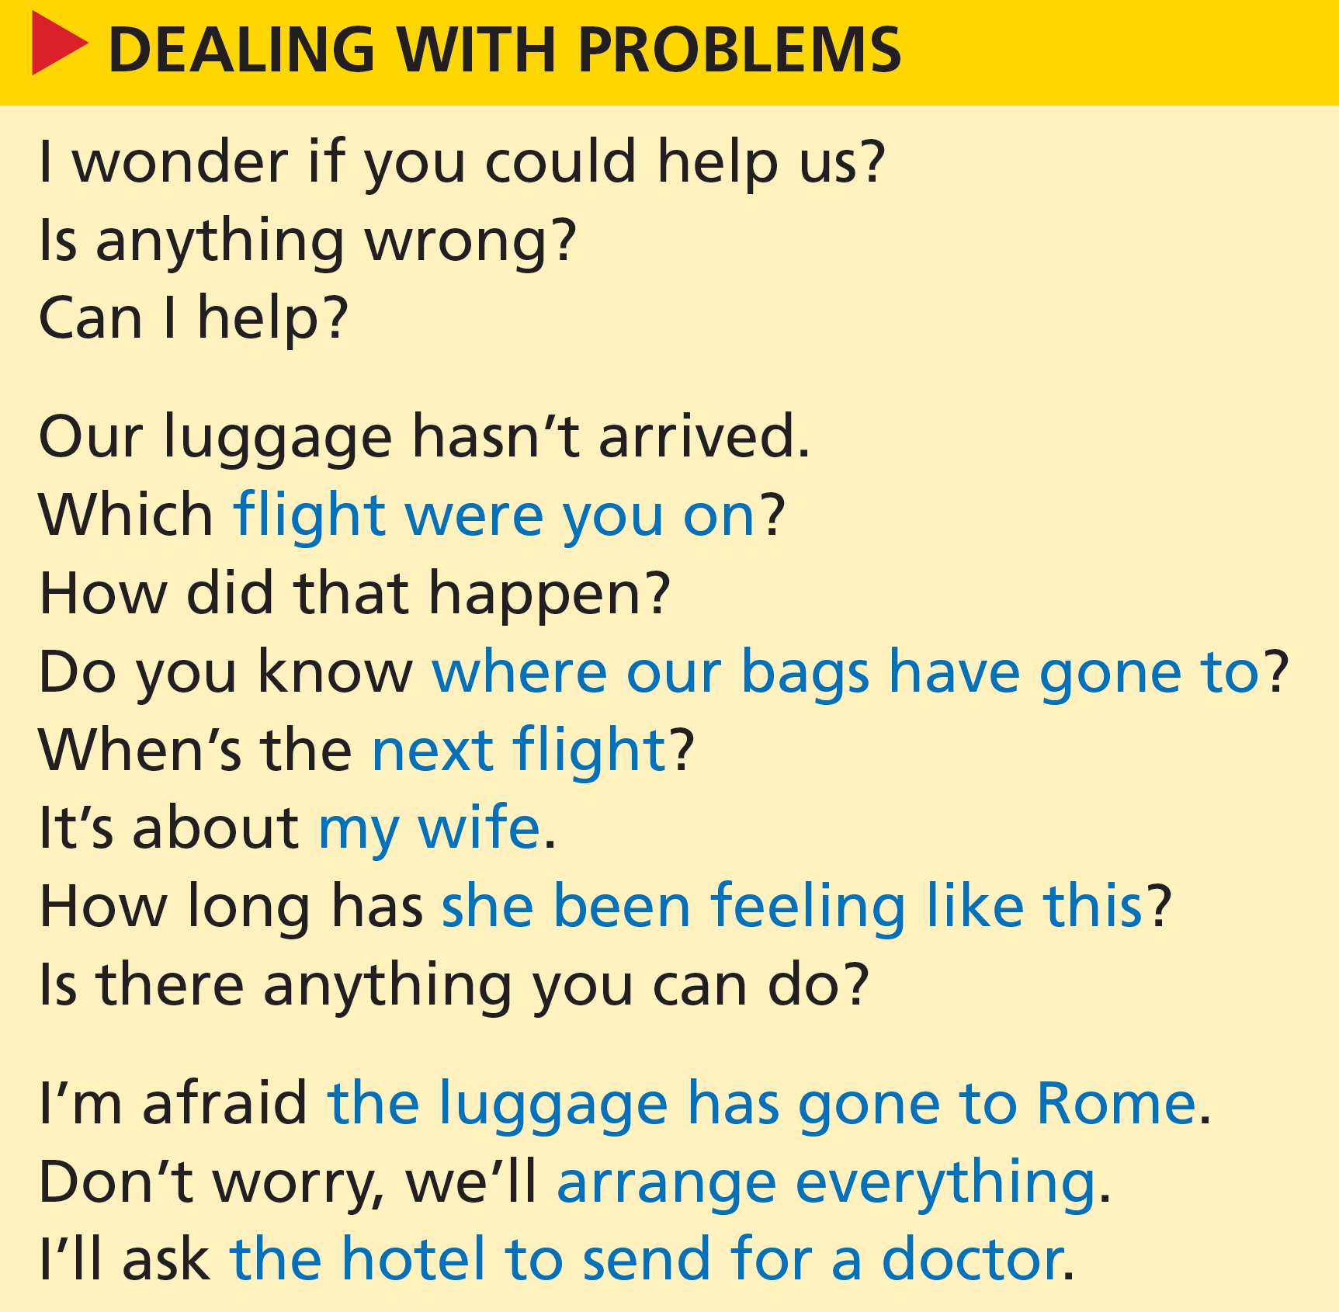
3 Look at the expressions for dealing with problems. Can you remember who said what? Write G (guide) or T (tourist) next to the expressions. Then listen to the conversations again and check.
Track 67
T
G
G
T
G
T
T
T
T
G
T
G
G
G
8d-p. 100

Slide 48
Script
Track 67
T = tourist, G = guide
1
T: I wonder if you could help us. Our luggage hasn’t arrived.
G: Right. Are you with SunnyTimes tours?
T: Yes. Mr and Mrs Cameron.
G: And which flight were you on, Mrs Cameron?
T: The FastJet flight from Manchester. I think it’s FJ2498. We’ve been talking to some of the other passengers and their luggage has come through, no problem.
G: Ah, yes. It seems some bags have gone to another airport. Flight FJ2498?
T: Yes, that’s right. Do you know which airport our bags have gone to?
G: Yes, I’m afraid the luggage has gone to Rome.
T: Rome? How did that happen?
G: I’m not sure, but all the missing bags are coming on the next flight.
T: But when’s the next flight?
G: It’s tomorrow morning. Don’t worry, we’ll arrange everything. Which hotel are you staying at? Your bags will go there directly.
T: But all our summer clothes are in the suitcases.

Slide 49
Script
Track 67
2
G: Hello, Mr Jones. Is anything wrong? Can I help?
T: Well, it’s about my wife, actually. She hasn’t been feeling well for a couple of days.
G: I’m sorry to hear that. Is it something she’s eaten, do you think? Or just travel sickness?
T: I don’t know. She’s had a temperature all night, but she feels cold.
G: OK, … erm, how long has she been feeling like this?
T: A couple of days? Yes, since the boat trip on Tuesday. Is there anything you can do?
G: Well it’s probably nothing to worry about. But I’ll ask the hotel to arrange for a doctor, just in case.
T: That’s great, thank you.

Slide 50
4 Work as a class. Are the problems solved? How?
EXAMPLE ANSWERS
1 The tour guide says the problem is solved – the bags will arrive tomorrow morning on the next flight and will be delivered to the hotel – but the tourist is still concerned because all the summer clothes are in the suitcases.
2 The tour guide arranges for a doctor and the tourist is happy with that and says thank you (but his wife is still unwell).
8d-p. 100

Slide 51
5 Pronunciation strong and weak forms
a Look at the position of to in these sentences. Listen to the sentences. In which sentence is to strong /tuː/? In which one is it weak /tə/?
Track 68
1 Do you know which airport our bags have gone to?
2 Yes, I’m afraid the luggage has gone to Rome.
strongly stressed
weakly stressed
b Listen and repeat these questions. Use strong or weak forms of at, from and for. Then work in pairs. Ask the questions and give your own answers.
Track 69
1 Which hotel are you staying at?
2 Are you staying at the Ocean Hotel?
3 Where have you travelled from?
4 Why haven’t we heard from the airline?
5 What have we been waiting for?
6 Are you waiting for the manager?
8d-p. 100

Slide 52
6 Work in pairs. Choose one of the conversations from Exercise 2. Take a role each. Look at the audioscript on page 186 and prepare your role. Then close your books and practise the conversation.
7 Take the roles of a tourist and a tour guide. Choose from the problems in Exercise 2 and act out two conversations. Use the expressions for dealing with problems to help you.
8d-p. 100

Slide 53
8e Hello from London!
Writing a text message
1 Read the message from Lynne. Answer the questions.
1 Where has Lynne come from and where is she now?
2 Who do you think the message is for? Friends, family, or both?
3 What does Lynne say about the people and the city?
4 What has she been doing?
1 has come from Brisbane; is now in London
2 probably friends – because she mentions ‘her uncle’ in Edinburgh (but it could be both)
3 people – fantastic; London – massive
4 she’s been shopping in Oxford Street, seen the Shard, done the Harry Potter tour, had a boat trip along the river
8e-p. 101

Slide 54
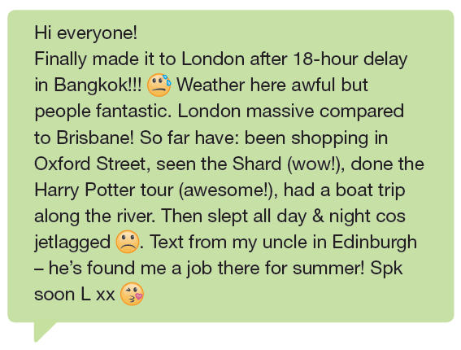

8e-p. 101

Slide 55
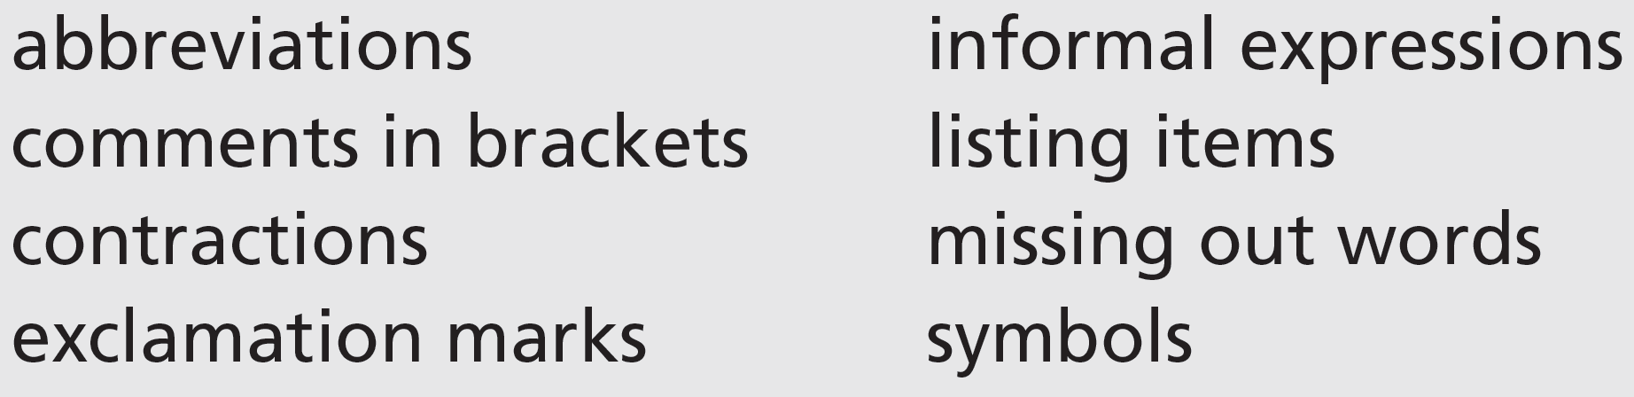
2 Writing skill informal style
a Read the message again. Which of these features of informal style does Lynne use?
Lynne uses all the features in her message:
abbreviations: cos (because); Spk (Speak / Let’s speak / We’ll speak); L (Lynne)
comment in brackets: (wow!); (awesome!)
contractions: he’s
exclamation marks: Bangkok!!!; (wow!); (awesome!); for summer!
informal expressions: Hi; made it; fantastic; awesome
listing items: So far have: been shopping in Oxford Street, seen the Shard (wow!), done the Harry Potter tour (awesome!), had a boat trip along the river.
missing out words: (I) Finally made it; after (an) 18-hour delay; (The) Weather here (is) awful but (the) people (are) fantastic. London (is) massive; So far (I) have; Then (I) slept all day; (I was) jetlagged; (I had a) Text from my uncle in Edinburgh – (he) has found me a job there for (the) summer!
symbols: sweat from forehead face (after ‘Bangkok!!! In line 1); unhappy face (after ‘jetlagged’ and before full stop in line 4); blowing kisses face (after ‘L xx’ at end)
8e-p. 101

Slide 56

b Look at this extract from the message. The words I and an are missing. Mark their position in the complete sentence.
Finally, I / I finally made it to London after an 18-hour delay in Bangkok!
c Mark the places in the message where Lynne has missed out words. What are the words?
(The) Weather here (is) awful but (the) people (are) fantastic. London (is) massive compared to Brisbane! So far (I) have: been shopping in Oxford Street, seen the Shard (wow!), done the Harry Potter tour (awesome!), (and) had a boat trip along the river. Then (I) slept all day & night cos (I was) jetlagged. (I had a) Text from my uncle in Edinburgh – (he) has found me a job there for (the) summer! Spk (Speak / Let’s speak / We’ll speak) soon L xx
8e-p. 101

Slide 57
d Rewrite the sentences in full.
1 city massive & noisy!
2 not got theatre tickets cos fully booked
3 been visiting Tower of London – scary!
4 took selfies (lots) on Oxford St
5 can’t understand London accent (trying!)
6 text from Jo – arriving Sunday
1 The city is massive and noisy!
2 I haven’t got any theatre tickets because the theatre was fully booked.
3 I've been visiting the Tower of London – it’s scary!
4 I took lots of selfies on Oxford Street.
5 I can’t understand the London accent, though/but I‘m trying (to)! / I‘m trying to understand the London accent, but I can’t.
6 I had a text from Jo – she’s arriving on Sunday.
8e-p. 101

Slide 58
e Rewrite the sentences. Miss out words where possible.
1 The weather is wet and it has been very cold sometimes.
2 I’ve been touring all the typical places – it’s exhausting!
3 The people here are very kind and they have helped me a lot.
4 I took some photos of some pigeons – they’re everywhere!
5 I haven’t heard anything from Anton yet.
6 I’m getting a bus up to Edinburgh because flying is too expensive.
1 Weather wet & very cold.
2 Been touring typical places – exhausting!
3 People here very kind & have helped a lot.
4 Pigeons everywhere! Took photos.
5 Not heard from Anton yet.
6 Getting bus to Edinburgh cos flying expensive.
3 Choose a place you have visited or would like to visit. Make notes. Use the questions in Exercise 1 as a guide.
8e-p. 101

Slide 59
4 Decide who to write to. Write a message of about 75 words describing your trip. Use some of the features of informal style from Exercise 2a and miss out words which are not necessary.
5 Send your message to someone in your class. Then read the message you have received. Use these questions to check your classmate’s message.
• Is everything clearly expressed?
• Are there any sections you do not understand?
6 Work in pairs. Tell your partner about the message you have received.
A: I got a message from Daisuke the other day.
B: Oh! How’s he getting on?
8e-p. 101

Slide 60
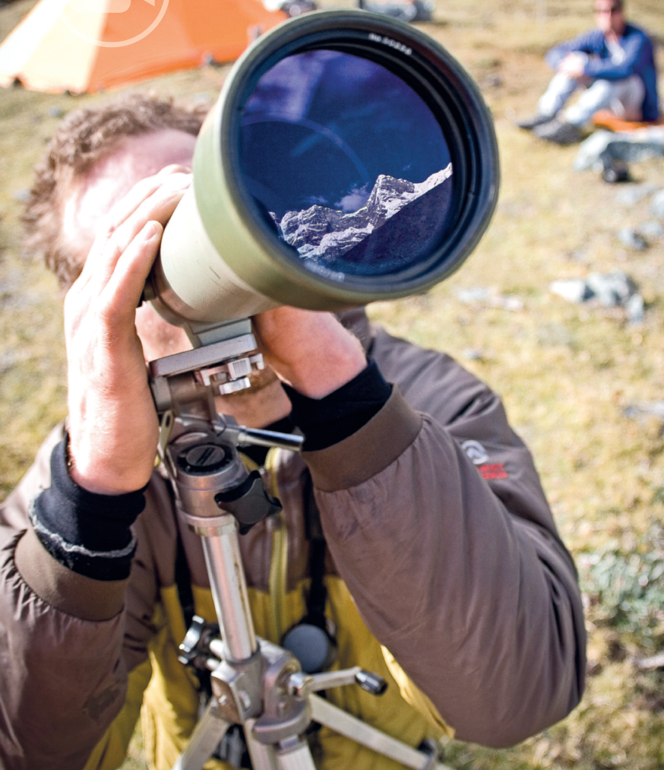
8f Questions and answers
Before you watch
1 You’re going to watch two videos in which National Geographic Explorers give their personal answers to questions. Before you watch, discuss these questions.
1 What kind of work do explorers do? Where do they work?
2 What items might they need to take with them when they’re exploring?
3 Why do you think people become explorers?
See next slide for answers
Cory Richards on the Cordillera Blanca in Peru
8f-p. 103

Slide 61
Exercise 1
EXAMPLE ANSWERS
1 They travel the world and go to places other people don’t go to. They do research, they find out about unknown areas, and they are often involved with the conservation of plants, wildlife, and the way of life of traditional people and their languages. They take photos and make films. They often work outdoors in dangerous and inhospitable places.
2 Items: cameras, binoculars, good boots, climbing equipment, waterproof clothing, maps, GPS systems, sunglasses, knife, camping and/or survival equipment.
3 To see the world, because they have a sense of adventure, to get away from ordinary life, to pursue their interest in science or geography or geology, to help protect and conserve the environment.

Slide 62
2 Key vocabulary
a Read the sentences. The words in bold are used in the video. Guess the meaning of the words.
1 If you want to watch animals in the wild, a pair of binoculars is very useful.
2 I’d get really burned if I didn’t use sunblock.
3 I’m not very good with a paintbrush – I prefer doing pencil drawings.
4 All children are curious about the world around them.
5 I’ve been making good progress in Italian since I started classes.
b Match the words in bold in Exercise 2a with these definitions.
3
2
1
5
4
a a tool to paint with
b cream that protects your skin from the sun
c equipment with lenses for looking at things far away
d improvement and development
e interested in something and wanting to learn about it
8f-p. 102

Slide 63

While you watch
Video 1: What item would you not leave home without?
3 Read what four of the explorers say about why they chose the items they take with them. What do you think they are talking about?
Students’ own ideas at this stage
1 Carlton Ward, photographer
‘without a _______________, we’d still be paddling in circles somewhere’
2 Amy Dickman, zoologist
‘_______________, just to have a break at the end of the day’
3 Chris Thornton, archaeologist
‘_______________. I’m very, very white.’
4 Cory Richards, photographer
‘a _________________ to record what I’m experiencing’
4 Watch the video. Check your ideas from Exercise 3.
1 GPS
2 DVDs
3 sunblock
4 pencil / camera / paintbrush / vehicle / way
8f-p. 103

Slide 64

5 Watch the video again. Tick the items the explorers mention.
camera
binoculars
knife
GPS
DVDs
headlamp
hat
sunblock
local person
pencil
paintbrush
6 Work in pairs. Which of the items in Exercise 5 surprised you? Did the explorers mention any of the items you discussed in Exercise 1 question 2?
Students’ own answers
8f-p. 103

Slide 65
Videoscript
Questions and answers
0.00–0.13 ‘Uh, the one thing I wouldn’t leave home without …’
‘Mmm, eh …’
‘That’s a good question.’
‘Phew.’
0.14–0.19 John Francis, ecologist You know, when I’m packing if I don’t have a camera or my binoculars then I feel nude.
0.20–0.24 Andrés Ruzo, geologist I’ve got a habit of carrying like a rosary and a knife.
0.25–0.30 Carlton Ward, photographer My GPS. Without a GPS, we would be still paddling in circles somewhere.
0.31–0.40 Amy Dickman, zoologist I always take DVDs. It’s very sad, but it just gives me something to look at that’s nothing to do with the field and just have a break at the end of the day.
0.41–0.49 Eric Patterson There’s a lot of times where the power goes out. My headlamp has become sort of an essential tool even though I might not have thought so at first.
0.50–0.59 Lee Berger, paleoanthropologist It’s my hat. I’ve got a hat that I wear all the time and I wouldn’t … It’s my lucky hat and so I make my discoveries with my hat on.
1.00–1.03 Chris Thornton, archaeologist Sun block. I am very, very white.
1.04–1.06 Kuenga Wangmo, archaeologist I wear this … It’s supposed to protect you.
1.07–1.14 Aziz Abu Sarah, humanitarian Items – I don’t care about anything. I need to make sure I have a local with me. That’s the one thing I would never give up on.
1.15–1.26 Cory Richards, photographer You don’t want to leave home without a pencil, a camera, a paintbrush. One thing I would not leave home without is a vehicle or a way to record that which I am experiencing.

Slide 66

Video 2: Why is it important to explore?
7 Read what the explorers in the video say. What do you think the missing word is? Then watch the video and check your ideas.
1 John Francis, ecologist
‘If you have _________________ and you don’t pursue them, then to me it’s a life unlived.’
2 Laly Lichtenfeld, big cat conservationist
‘It keeps _________________ exciting, I mean that’s what exploring is about.’
3 Enric Sala, marine ecologist
‘Without exploration, there would be no _________________ .’
4 Lee Berger, paleoanthropologist
‘We think we _________________ how things work, but we don’t.’
questions
life
progress
understand
8 Watch the video again. Who gave the most interesting answer, in your opinion?
Students' own ideas
8f-p. 103

Slide 67
Videoscript
Questions and answers
0.00–0.07 Lee Berger, paleoanthropologist Oh … I … that’s not hard to say.
0.08–0.09 Catherine Workman, conservation biologist Mmmm, that’s tough.
0.10–0.14 Laly Lichtenfeld, big cat conservationist Mmmm, let me think about that one for a minute.
0.15–0.25 John Francis, ecologist Exploration is in people’s blood – some more than others, I think. But if you have questions and you don’t pursue them, then to me it’s a life unlived.
0.26–0.32 Emily Ainsworth, anthropologist It’s part of human nature to be curious and to want to learn more about the world.
0.33–0.38 Juan Martinez, environmentalist It’s where you find yourself, or you find new things, where you grow.
0.39–0.42 Laly Lichtenfeld It keeps life exciting. I mean that’s what exploring is about.
0.43–0.50 Clare Fieseler, marine ecologist That’s what drives people to the highest mountain and the deepest crevices and I don’t think that will ever stop.
0.51–1.02 Enric Sala, marine ecologist Without exploration, there would be no progress. Exploration is trying to learn why and how and where.
1.03–1.17 Lee Berger We think we know this place, but we don’t. We think we know ourselves, but we don’t. We think we understand how things work, but we don’t.
1.18–1.23 Catherine Workman By knowing what’s out there, we care about what’s out there.
1.24–1.33 Cory Richards If we have more to care about, then we engage more fully with our world and more fully with our human family and we act, you know, with love.
1.34–1.37 Lee Berger That’s why exploration is so fundamentally important.

Slide 68

After you watch
9 Vocabulary in context
a Watch the clips from the videos. Choose the correct meaning of the words and phrases.
b Answer the questions in your own words. Then work in pairs and compare your answers.
1 Does the power ever go out where you live? What do you do when that happens?
2 Do you think it’s human nature to be curious? What else is human nature?
3 What kind of thing do you think drives artists and business people?
EXAMPLE ANSWERS
1 Students’ own ideas
2 It is human nature to fall in love, to have ambitions, to get angry.
3 Artists: desire to create something, to be famous.
Business people: desire to be rich, to lead people.
8f-p. 103

Slide 69
Videoscript
Questions and answers
c
b
c
b
a
1 There’s a lot of times when the power goes out.
a I’m really tired
b there’s no petrol
c we have no electricity
2 I need to make sure I have a local with me.
a a map of the area
b a person from the area I’m in
c a place to stay
3 It’s part of human nature to be curious …
a experiencing wild places
b our education
c the way we are
4 It’s where you find yourself, where you find new things, where you grow.
a feel happy
b understand who you really are
c want to live
5 That’s what drives people to the highest mountain …
a makes people want to go
b takes people in a car
c works as a driver for explorers

Slide 70
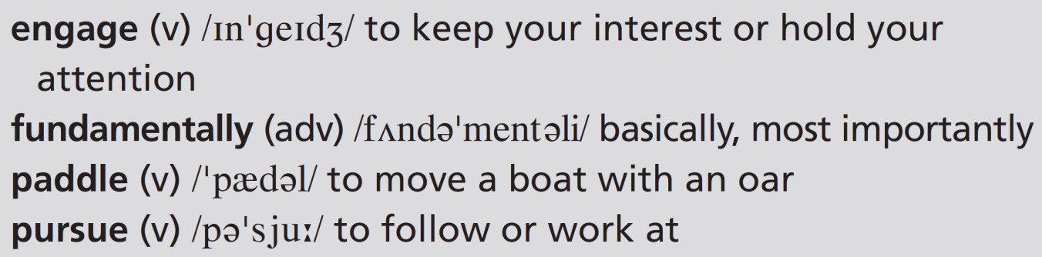
10 Work in pairs. Discuss the questions.
1 What would you not leave home without if you were travelling?
2 Why is it a good idea to travel?
EXAMPLE ANSWERS
Students’ own ideas
1 I wouldn’t leave home without my mobile phone because it’s a way of communicating with people, a GPS system to help me know where I am going, and a camera to record my journey.
2 It’s a good idea to travel because you see new places, meet new people, and find out what it is like to be in new places.
8f-p. 103

Slide 71
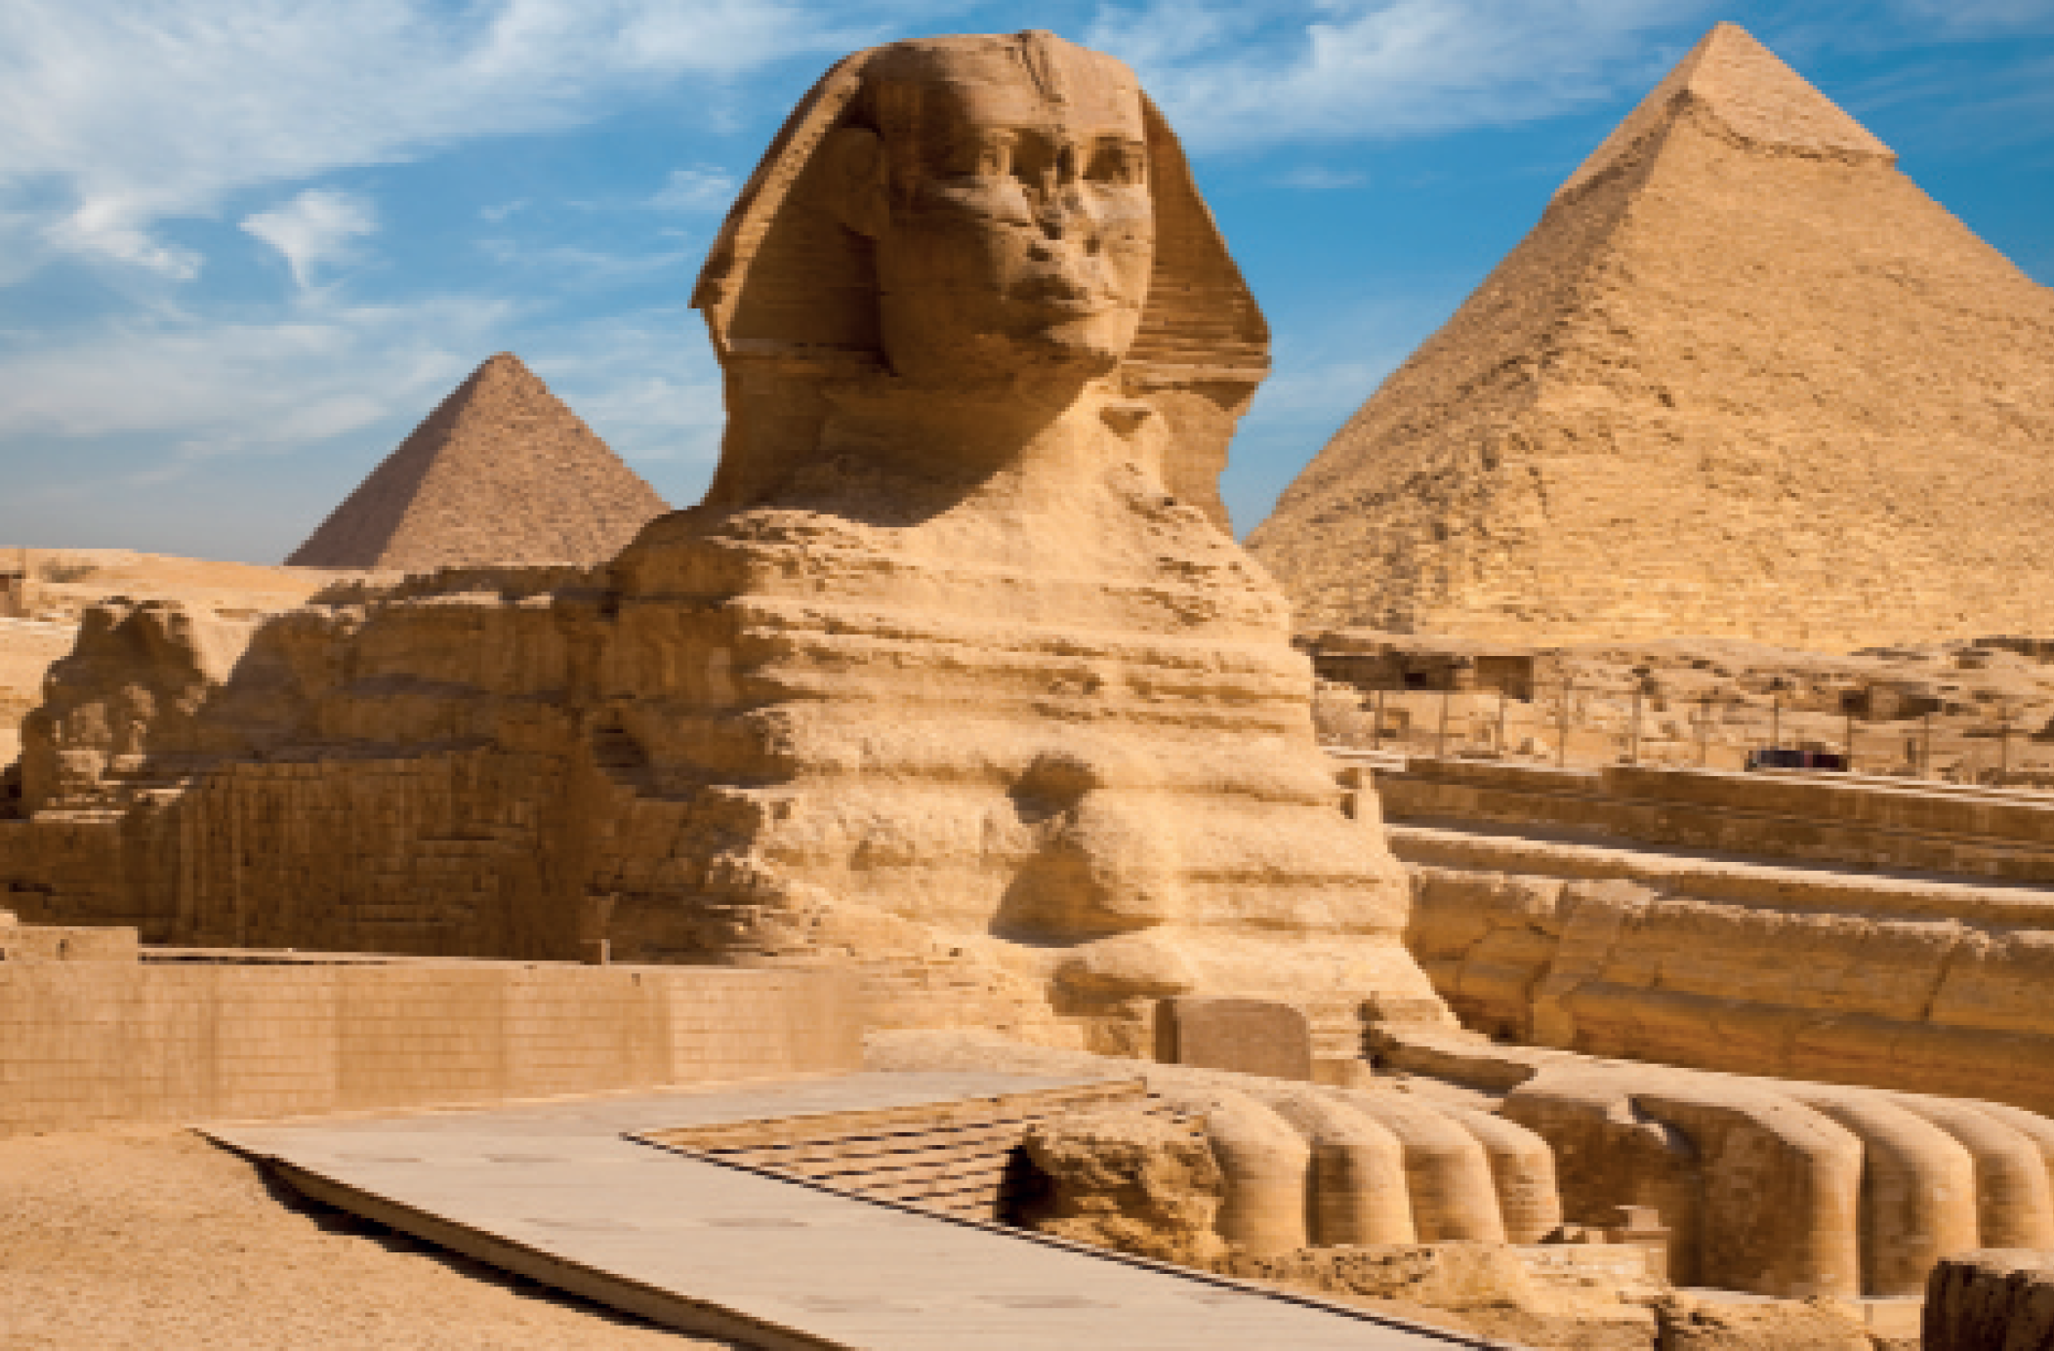
UNIT 8 REVIEW AND MEMORY BOOSTER
Grammar
1 Complete the article about Thomas Cook with the correct verb tense or form. Use the following: past simple, present perfect simple, present perfect continuous, -ing form or infinitive with to.
U8 Review-p. 104

Slide 72
Before 1872, people 1 ____________________ (not / travel) for pleasure very much. Then a man called Thomas Cook 2 ____________________ (change) everything when he 3 ____________________ (form) a travel agency, Thomas Cook & Son. Cook aimed 4 ____________________ (provide) educational and cultural tours. His son was successful in 5 ____________________ (expand) the business around the world. At first, foreign travel was expensive, but incomes 6 ____________________ (rise) since those days. Nowadays, many millions of ordinary people expect
7 ____________________ (go) on holiday at least once a year. In the twentieth century, holiday makers preferred 8 ____________________ (book) trips with travel agencies. For the last few years, travel agencies 9 ____________________ (struggle) because most people
10 ____________________ (make) their own plans online. Thomas Cook, however, is still one of the biggest travel companies in the world.
didn’t travel
changed
formed
to provide
expanding
have risen
to go
to book
have been struggling
have been making
U8 Review-p. 104

Slide 73
2 Answer the questions about the article in Exercise 1.
1 How has travel changed since the time of Thomas Cook?
2 Why do you think the travel agency Thomas Cook & Son was successful?
1 people didn’t travel for pleasure very much, now they do; foreign travel was expensive, now it isn’t; holidaymakers used to prefer booking trips with travel agencies, now many people make their own plans online
2 because incomes rose and ordinary people started travelling for pleasure; it offered organized educational and cultural tours that appealed to people; in recent years many millions of ordinary people now expect to have at least one holiday a year
U8 Review-p. 104

Slide 74


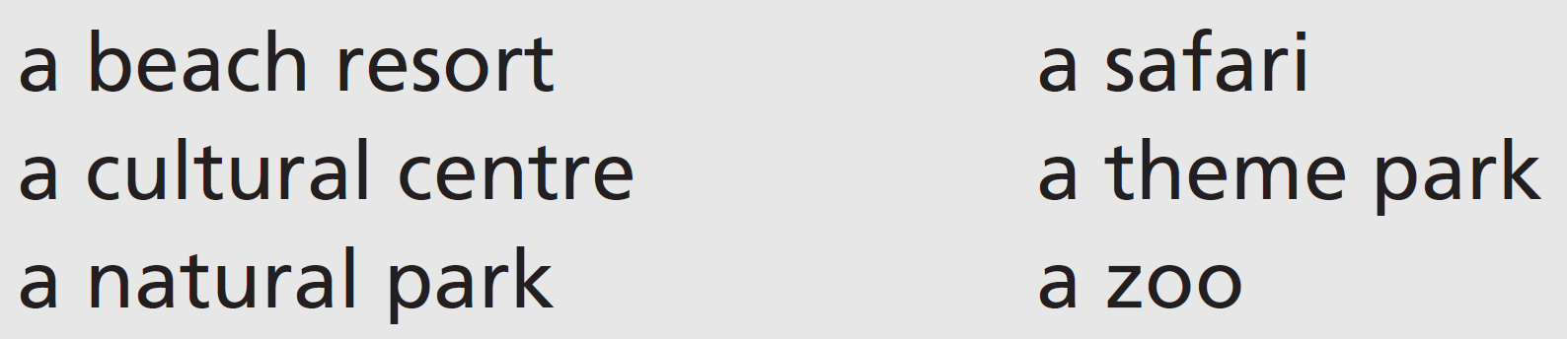
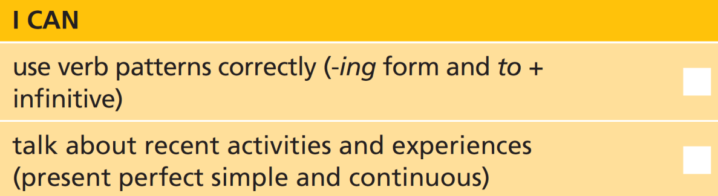
3 Write four true or false sentences about yourself with these verbs. Work in pairs and say if your partner’s sentences are true or false.
4 Work in pairs. Have you ever been to places like these on holiday? Ask and answer questions about your experiences.
U8 Review-p. 104

Slide 75

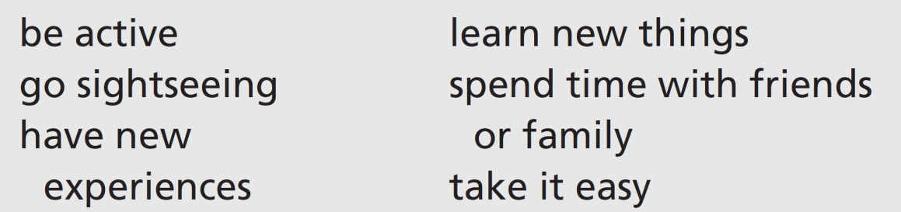
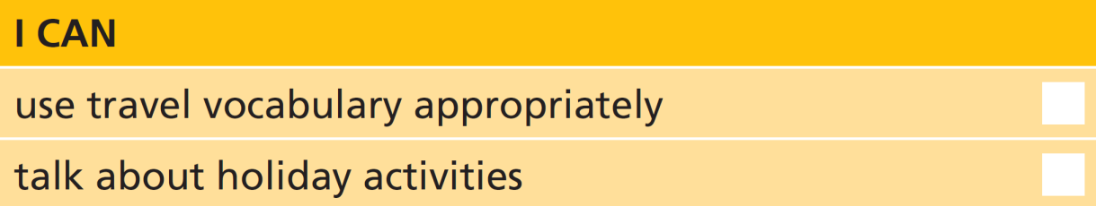
Vocabulary
5 Match nouns from A and B to make travel vocabulary. Then write questions with the expressions.
baggage allowance
boarding card
customs checks
flight delays
passport control
travel sickness/delays
6 Work in pairs. Which of these activities would you do in a seaside resort, a big city, a natural park and a campsite? Give your reasons.
Students’ own answers. You could do any of the activities in any of the places – it is mainly down to personal experience and preference.
U8 Review-p. 104

Slide 76
Real life
7 Read these sentences from a conversation at an airport. Put the sentences (a–h) in order (1–8).
3
6
7
1
8
5
2
4
a A: What? How has that happened?
b A: Well, let’s have another look. Calm down.
c A: Well, have you looked through all your pockets?
d A: Is anything wrong?
e B: Yes, I have. And I’ve checked the suitcase.
f B: I’ve been worrying so much about everything, and now this!
g B: I think I’ve lost the boarding passes.
h B: I don’t know. I thought they were in my pocket, but they aren’t there now.
U8 Review-p. 104

Slide 77
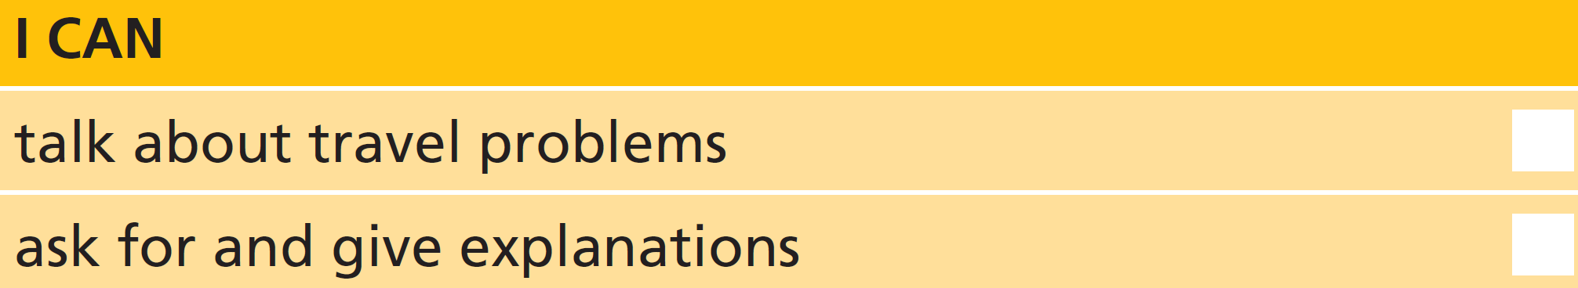
8 Work in pairs. Act out conversations similar to Exercise 7.
Conversation 1: Student A is a tourist and Student B is a tour guide. Student A has lost his/her passport.
Conversation 2: Student A is an airline official and Student B is a customer. The flight is cancelled.
U8 Review-p. 104

